Slide 1
Natural Language Processing to Understand Peer Reaction to Expressions of Stress
Presenter: Bontu Balcha and Claude Kwizera
Faculty Mentor: Rada Mihalcea [Professor], Artem Abzaliev[Phd student] and Ian Stewart[Postdoc]
Department of Computer Science and Engineering

Slide 2






Motivation
Social Media
Responses
People use social media platform to express their feelings and view
Positive
Negative
Neutral
Stress
Positive Frames
Negative feelings and the impact of stressful situations or contexts
Inducing Positive Perspectives with Text Reframing
How #Stressed tweets are being addressed? If positively ? In what way?
Notes:
have you ever been around someone who is feeling stressed? what do you think could have helped that person?
Now social media platforms have become where people express their feelings and views. The peer reaction on stressful situation sometimes do not help. This reaction can psychologically have a big impact on mental health of a stressed person. By taking a reference on recently published paper which talks about inducing positive perspective for a negative point of view without contradicting the original meaning, we tried to study how people on twitter react on #stressed tweets then we applied that for tweet replies.
add qualitative data/ Did you know? Mental health-stress , psychology
paper: can we reframe negative tweets is the question addressed Our Experiment: Can we test how stressed tweeps are being addressed [replies] and can we find out which positive frame is/are used by people.

Slide 3


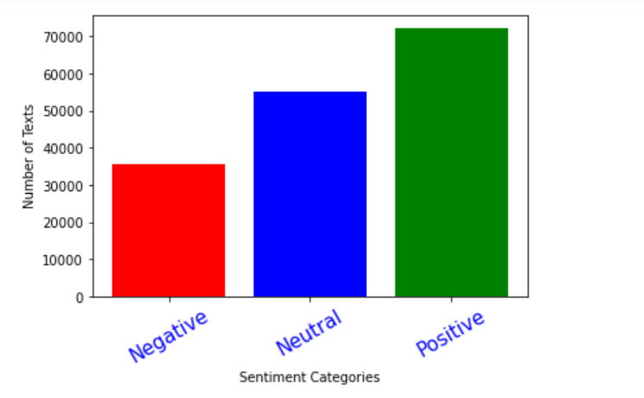
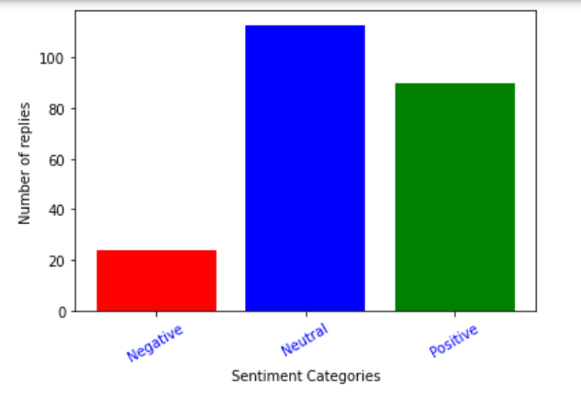
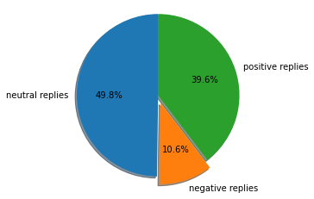
Sentiment Analysis
Data collection | Model training | Sentiment analysis
Peer Reaction
Do peer react more positively,neutrally or negatively to stress tweets?
Using around 16,000 fairly mixed sentiment based classified tweet dataset
we built different models
and chosen more accurate one
#stressed tweets
Accuracy: 87.2%
 | Multinomial Naive Bayes | Support Vector Machine | Random Forest
Countvectorizer | 69.7% | 86.4% | 82%
TFIDF | 56.7% | 87.2% | 82%
Notes:
While still thinking about that, we should have a system that can tell us to which context people usually reply for the #stress tweets:
to achieve that we collected a fairly mixed bunch of tweets classified dataset and we trained a model based on dataset so that it can predict reply sentiment. so we can answer the above question
after model training process we had to increase its accuracy day by day till we reached to 87% accuracy . then we applied the model to all tweet replies and we found that less number of people reply negatively
Total replies
total positive replies
total neutral replies
total negative replies
227
90
113
24

Slide 4


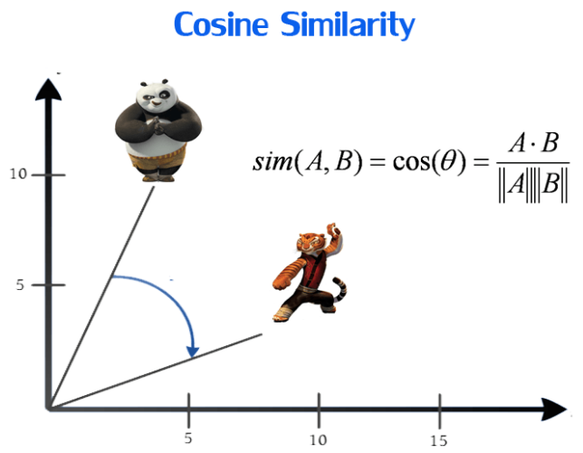
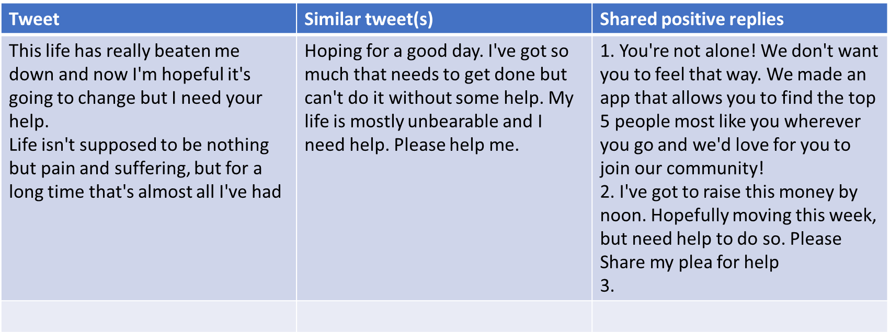
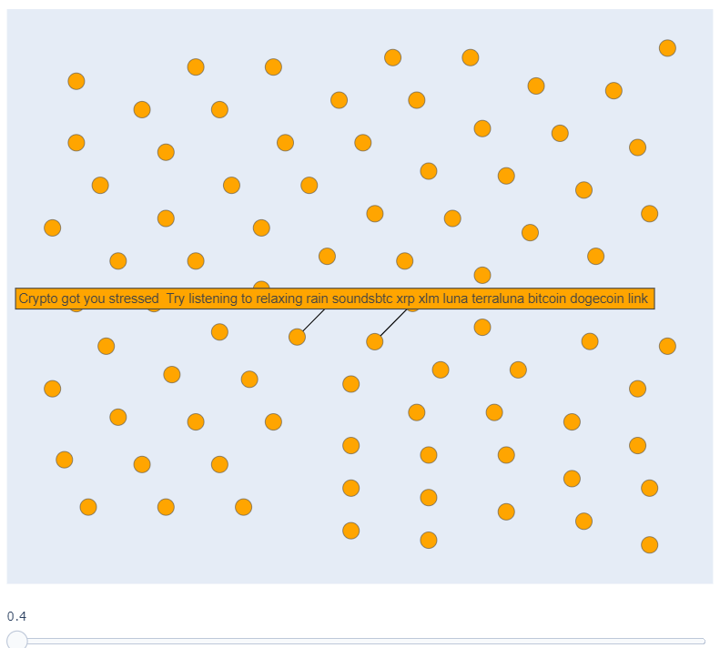
What to do with classified tweet replies?
Cosine Similarity
From the study of tweet similarity we share the positive replies from the most similar tweet to the tweet missing the positive replies
Notes:
so, by taking an advantage from that non negative replies
we developed two approaches , 1. rearranging the replies so that stressed person can view helpful replies at the top and negative replies after
as you can see on the right side we have two tweets which are sharing the replies. by using the
calculated cosine similarity between tweets, where they can share the positive replies if all replies can help both sides
and even use the reply from another tweet if it does not have any helpful one.
Due to the fact that these non negative replies psychologically impact different, we classify them into different positive psychology frames

Slide 5

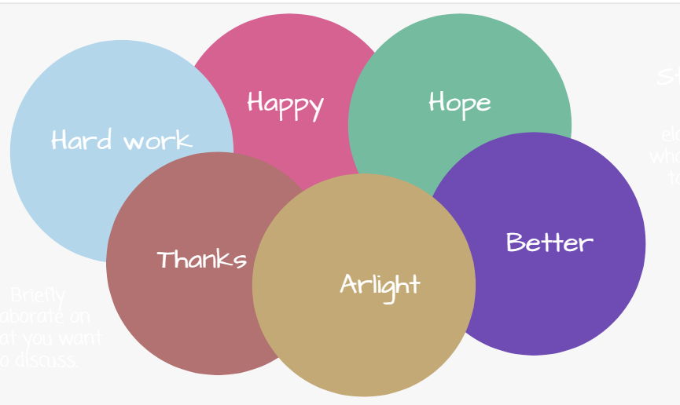
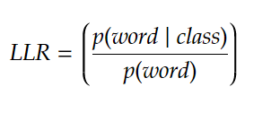
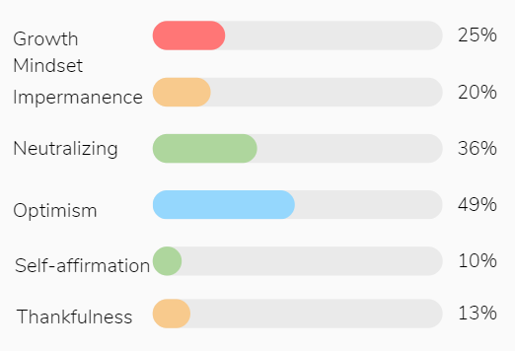
Positive Frame
What
Data
Experiments
positive perspective for the author without contradicting the original meaning
What features make up different frames?
Reframed #stressed tweets
Likelihood Ratio
8,349 sentence pairs and 12,755 structured multi-label annotations = 10240 single label annotation
Reframing Strategies
How well do basic NLP models do in predicting different types of positive frames?
After Upsampling
 | Multinomial Naive Bayes | Support Vector Machine | Random Forest | Logistic Regression
Countvectorizer | 0.52941176 | 0.61806843 | 0.65649755 | 0.6018877
TFIDF | 0.53362548 | 0.57980785 | 0.66121692 | 0.5643013
19776 single label annotation
Accuracy : 66.1 %
Notes:
Lets deeply talk about these positive frame. this comes from the idea of inducing positive perspective for the negative ones.
we have 6 theoretically motivated reframing strategies: the training dataset was optimism biased which affected the prediction of the trained model. to overcome this we used upsampling technique and managed to decrease bias. with our experiments ,we tried to find which type of words more define these 6 strategies and checked manually if it truly make a sense. We tried different basic NLP models and we ended up with 66.1% accurate model using balanced dataset

Slide 6



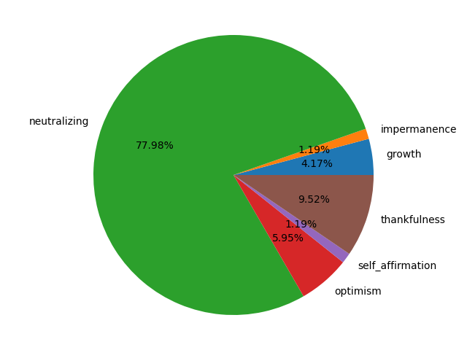
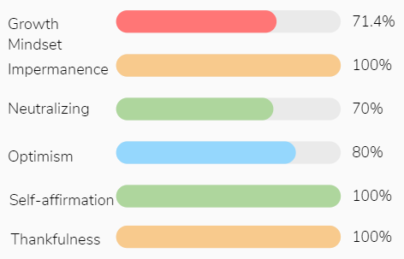
Positive Frames
How often do people online use positive frames?
Using Random Forest and Retrieved #stressed Tweet replies
Manual Check
Classification Report:
Prediction
 | precision | recall | f1-score | support
growth | 0.64 | 0.63 | 0.63 | 982
impermanence | 0.69 | 0.73 | 0.71 | 984
neutralizing | 0.51 | 0.5 | 0.5 | 965
optimism | 0.51 | 0.41 | 0.46 | 1006
self_affirmation | 0.78 | 0.88 | 0.83 | 1012
thankfulness | 0.76 | 0.8 | 0.78 | 984
Notes:
after knowing the behaviour of the classifier and features, we applied the bes accurate model to non-negatively classified tweet replies. from the prediction we got that the neutralizing frame was 77.9 % abundant than others followed by thankfulness and optimism. to insure that the model predicts the same as what human would expect, we did a manual check as you can see at the right side most of them are true positive. From experiment made on tweet replies we got we can say that people tend to use more neutralizing positive frame while talking to stressed people.
manual check less data for generalized conclusion performed well

Slide 7

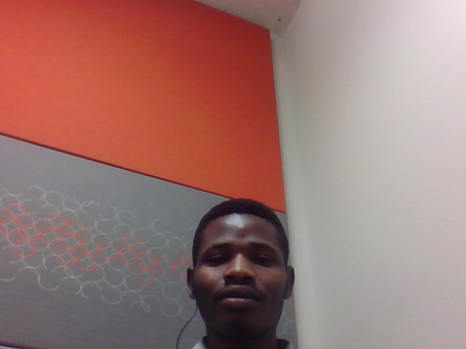
Conclusion
Takeaways
Future works
people often tend to not help in stressful condition so, it could help if the social media could have an automated machine that could give a helpful reply,comment or an advice to the person having stress. By either retrieval based dialog or generation based dialog system.
More data *
Best Classifiers *
Generation based Dialog * Systems
Nothing I choose ever seems to work outbut I want to make better choices truly.
i get kinda strong driving anxiety
Growth Mindset
Growth Mindset
Notes:
As a future works, we recommend to use more data for model training, as you can see these two sentences were predicted to the same positive frame strategies which is not true.
Better classifiers for training models, since we have seen that the better the classifier we used the better prediction we got
In addition , rather than using retrieval based dialog system for replying to the stressed tweets, generation based dialog system would be more better since it learns from itself

